Slide 1

Data Preprocessing and Model Preparation
By. Ethan Tornga

Slide 2
SQL Successes
Creating the table
Adding the data
Dropping unnecessary columns
Entrepreneurial Interest
Networking Importance
Creating calculated columns
Expected MBA Raise
% of Life Working

Slide 3
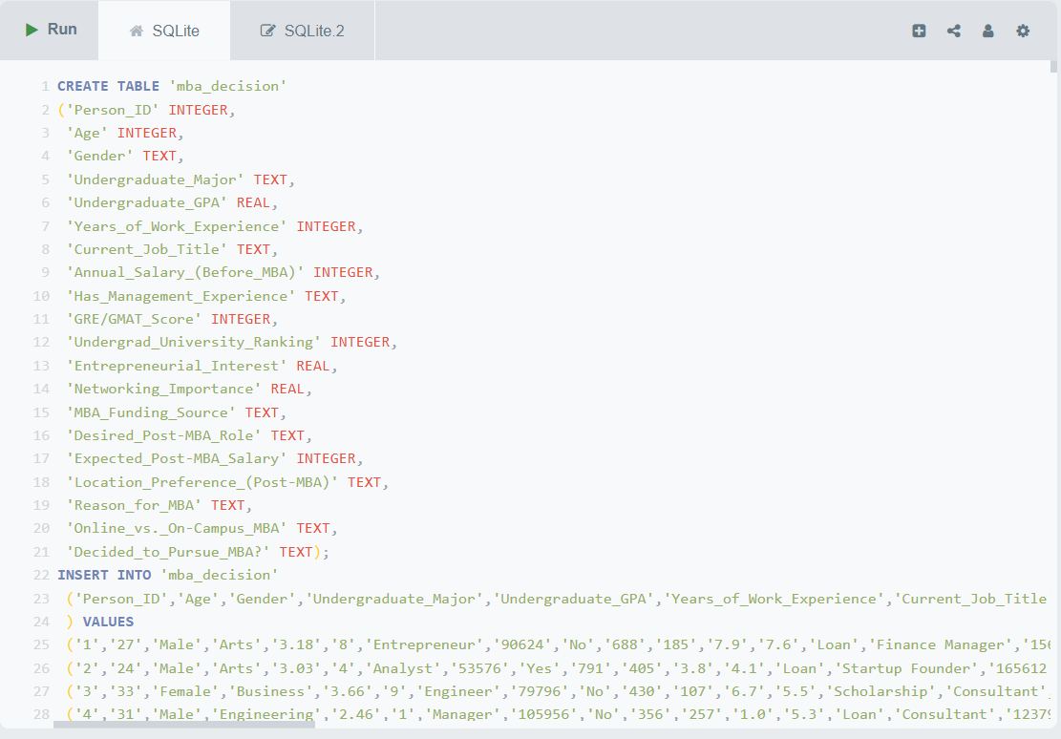
Creating the Table

Slide 4
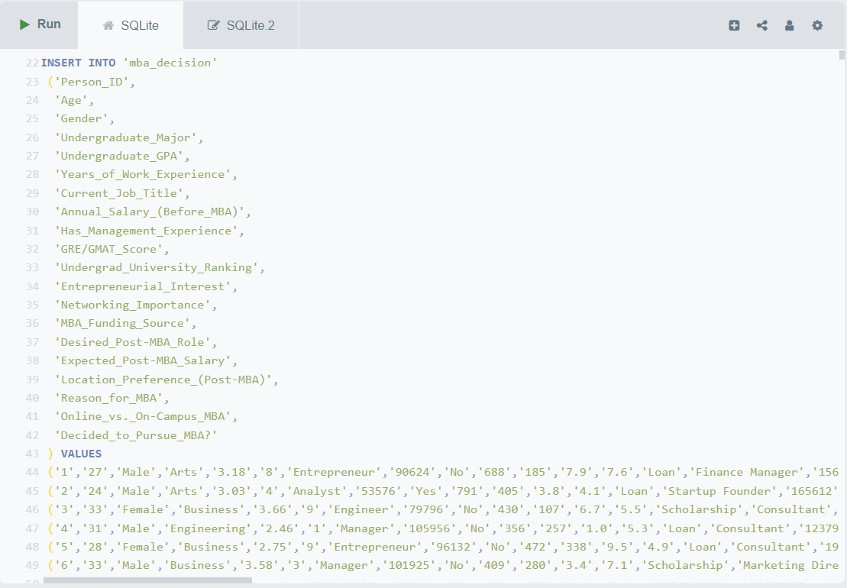
Inserting the Data

Slide 5
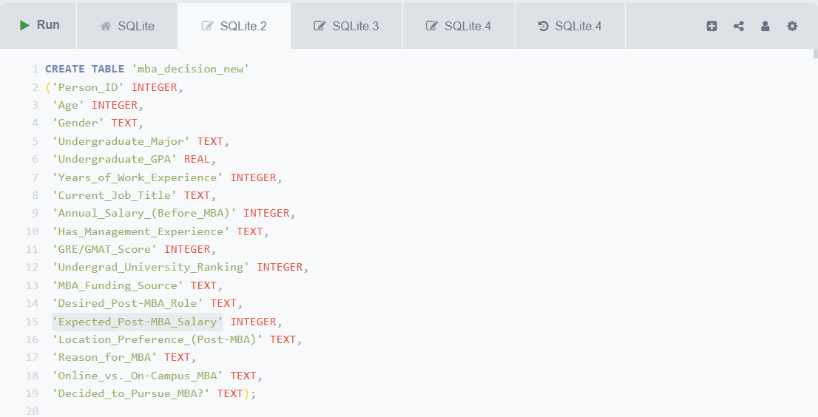
“Dropping” Columns

Slide 6
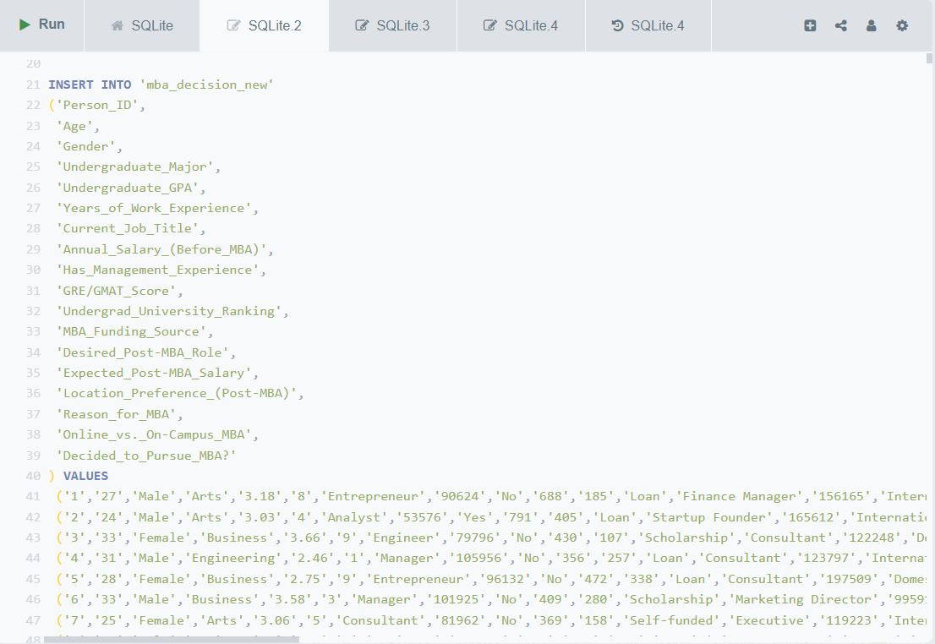
“Dropping” Columns

Slide 7
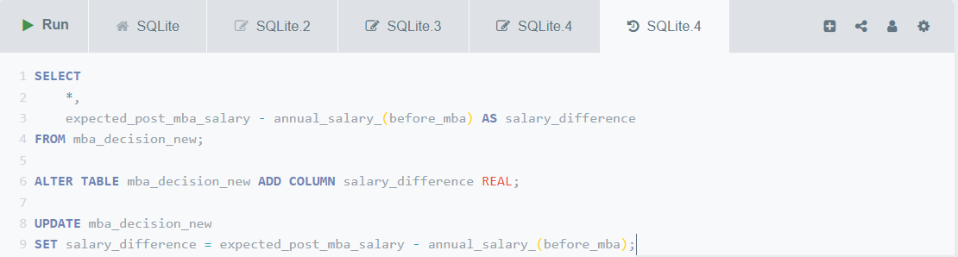
Calculated Columns

Slide 8
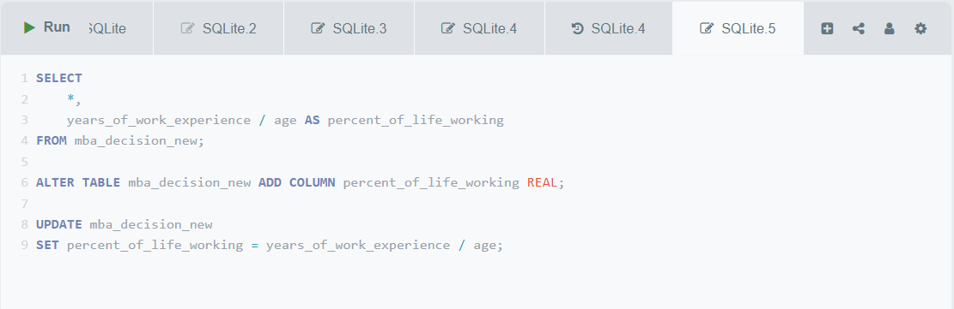
Calculated Columns

Slide 9
SQL Struggles
Azure pipeline issues
Naming issues
Cost management
MySQL unfamiliarity/issues
Knowledge gap
Time
SQLiteOnline
Coding
Saving

Slide 10
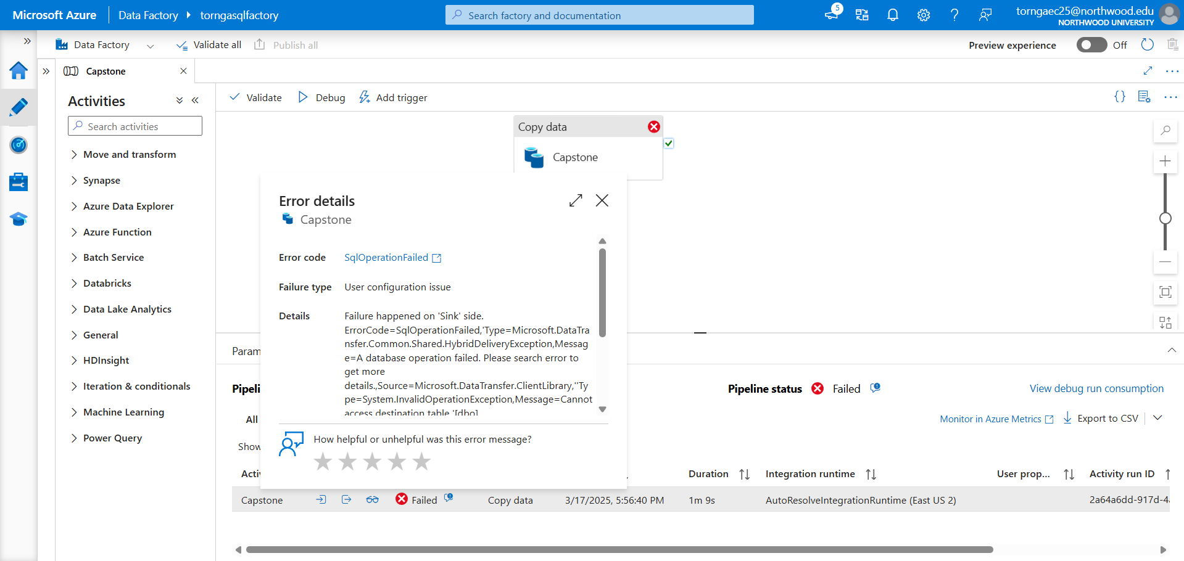
Azure

Slide 11
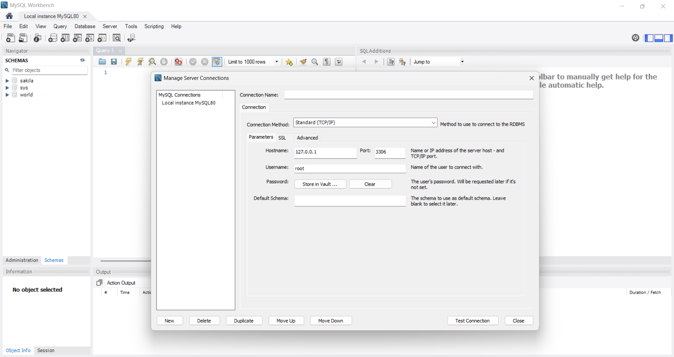
MySQL

Slide 12
Python Successes
GitHub -> Colab Connection
Data Cleaning/Preprocessing
Missing Values
Outliers
Encoding Dummy Variables
Feature Engineering
Modeling Start

Slide 13
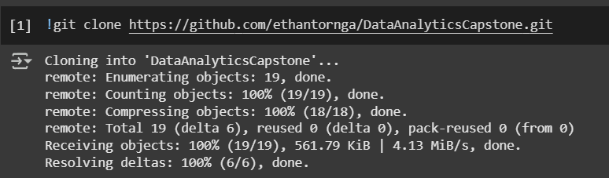
Connection

Slide 14
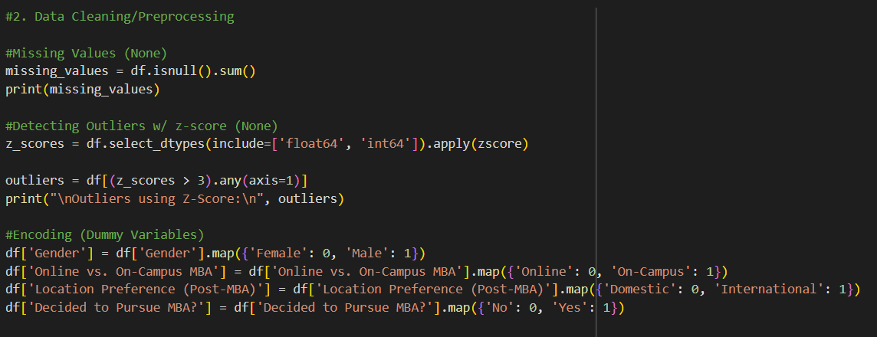
Cleaning and Preprocessing

Slide 15
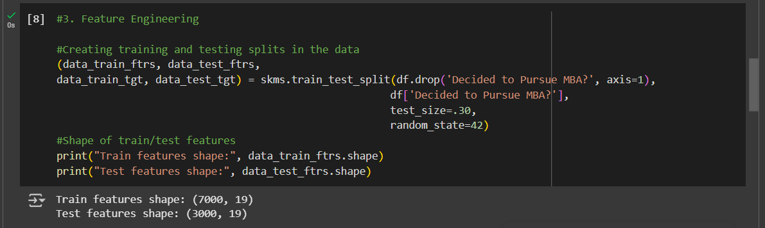
Feature Engineering

Slide 16
Python Next Steps
Determine Models to Use
2
Create Models
3
Analyze Models
4
Feature Selection
1

Slide 17
Modeling Plans
Predictive Analytics
Regression
Decision Trees
KNN Clustering
Naïve Bayes
Further review of previous material to find applicable models

Slide 18
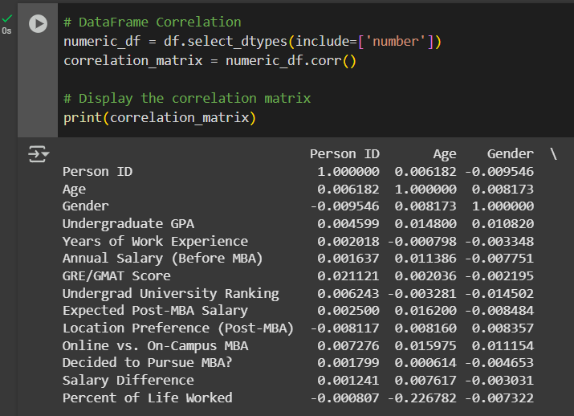
Initial Thoughts
Notes:
Non Linear Models
SVMs
Random Forest
Feaature Engineering

